Slide 1
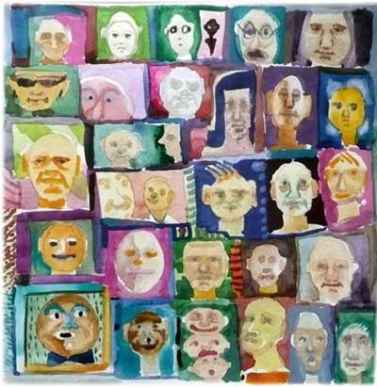
Similarity
Danielle Navarro
http://compcogscisydney.org/psyc2071/

Slide 2
Structure
Introduction to similarity
Simple theories of similarity
Geometric models
Featural models
Richer theories of similarity
Structure alignment
Stimulus transformation
https://flic.kr/p/d5ifKh

Slide 3
Perceptual and conceptual foundations for similarity

Slide 4
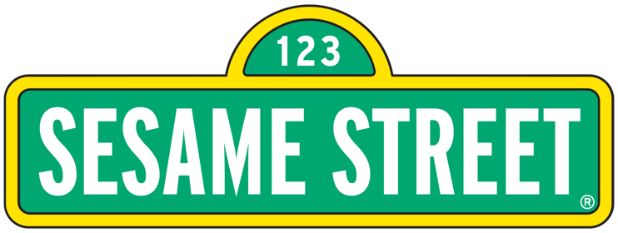
🎵 One of these things is not like the others // Three of these things are kind of the Same 🎵

Slide 5
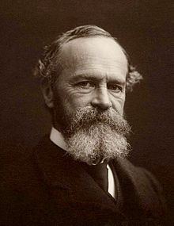
this sense of Sameness is the very keel and backbone of our thinking
- William James (1890)

Slide 6
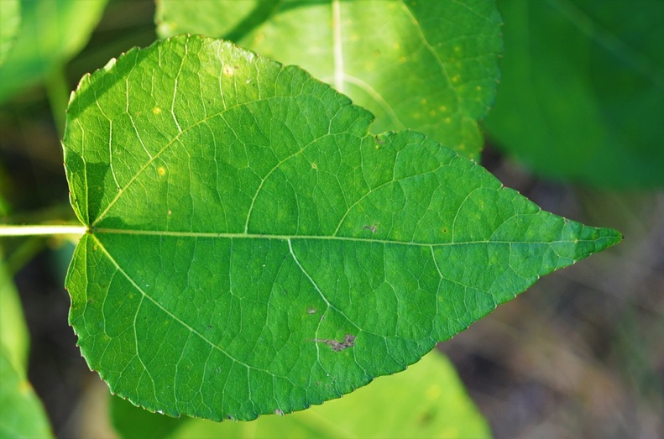
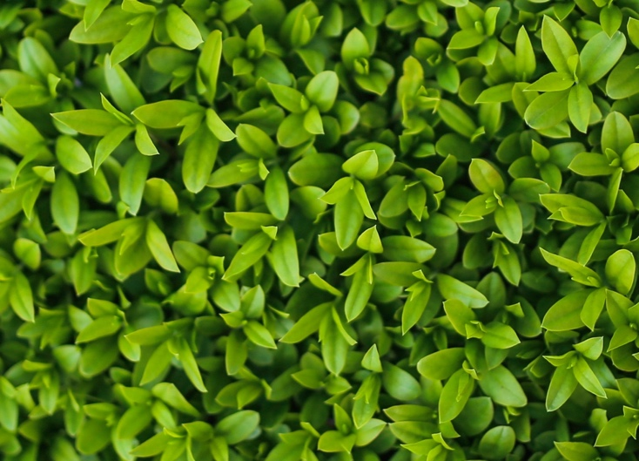
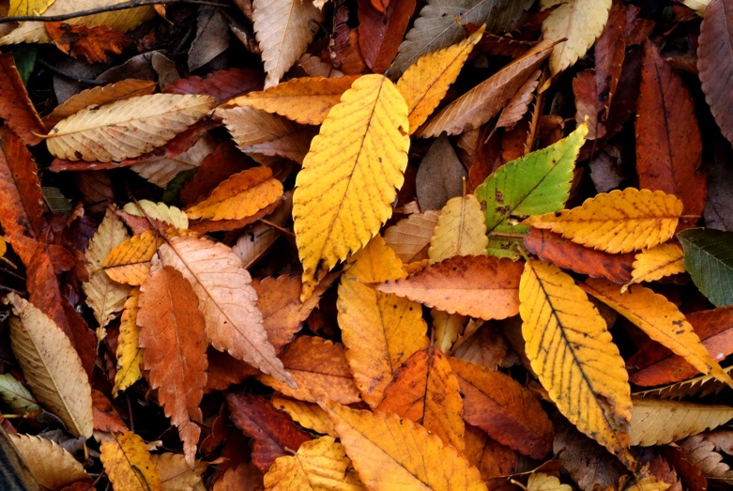
Shared perceptual features produce a sense of “likeness”

Slide 7
But we can set aside superficial differences to see a “structural” similarity
http://slightlywarped.com/animals-that-look-like-famous-people/

Slide 8
But we can set aside superficial differences to see a “structural” similarity
http://slightlywarped.com/animals-that-look-like-famous-people/

Slide 9
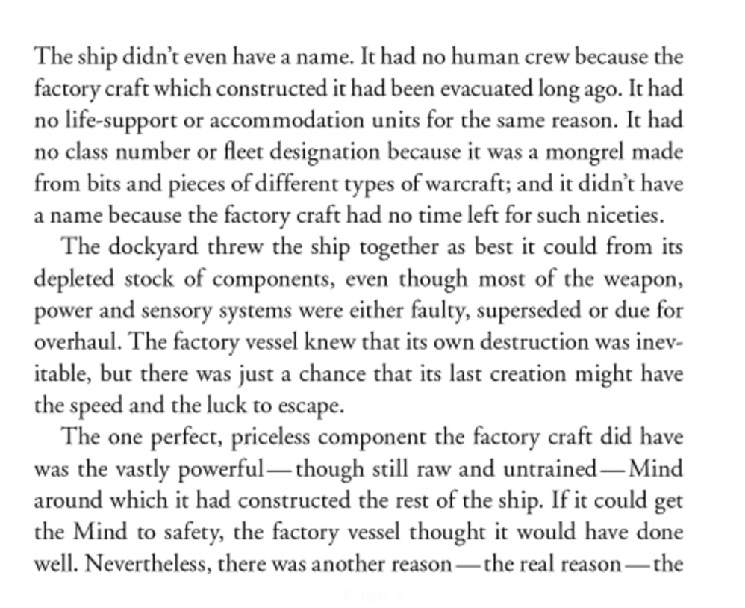
Similarity is not a purely perceptual phenomenon
Perceptually, these are drastically different stimuli!

Slide 10
We have a sense of similarity driven purely by conceptual connections
Both are:
Science fiction
Space opera
Post-scarcity society

Slide 11
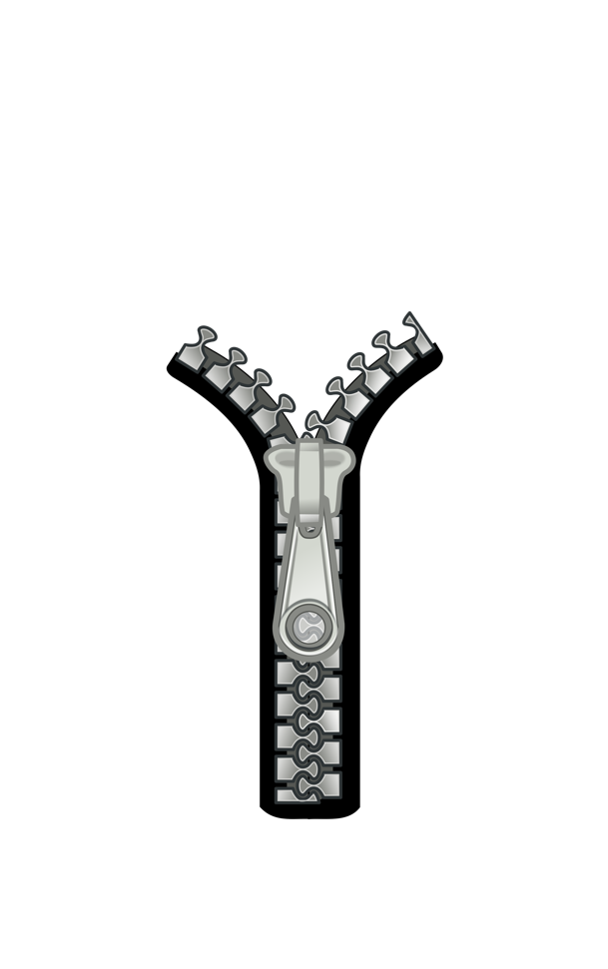
Similarity can do perceptual and conceptual work at the same time
DNA has a physical similarity to a zipper, which the visual system detects immediately
The genetic information in DNA is like a blueprint, which is a conceptual relationship

Slide 12
Similarity helps us form categories and make generalisations

Slide 13
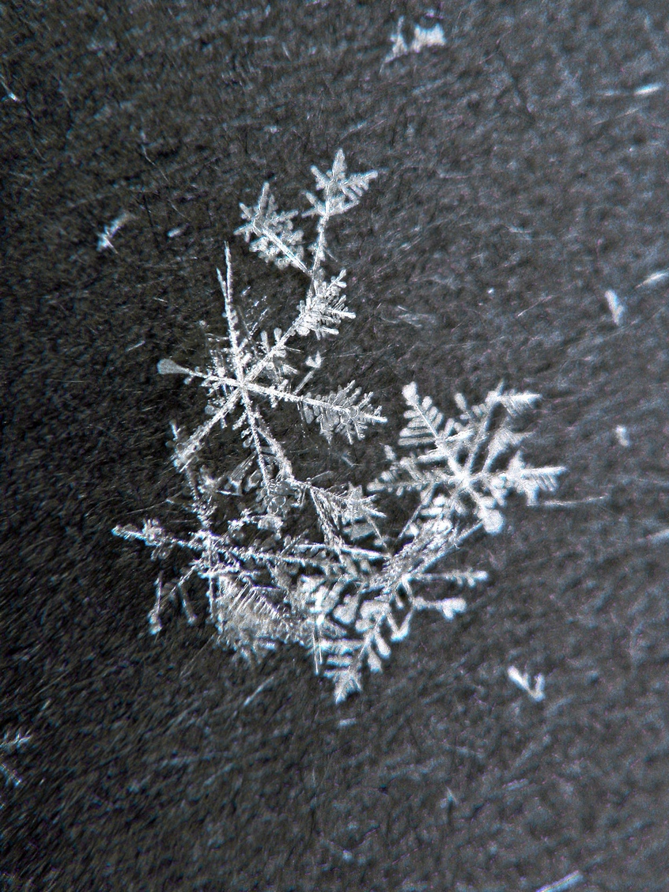
“The snowflake problem”
No two people are the same
No two events are the same
No two objects are the same
Nothing is the same as anything else

Slide 14
“The snowflake problem”
No two people are the same
No two events are the same
No two objects are the same
Nothing is the same as anything else
Why believe anything at all about the world or the future then?
What’s the point of guesses or predictions if everything is unique?

Slide 15
Because things are similar?

Slide 16
“Similarity, is fundamental for learning, knowledge and thought, for only our sense of similarity allows us to order things into kinds so that these can function as stimulus meanings. Reasonable expectation depends on the similarity of circumstances and on our tendency to expect that similar causes will have similar effects”
- Willard Van Orman Quine,1969

Slide 17
“Similarity, is fundamental for learning, knowledge and thought, for only our sense of similarity allows us to order things into kinds so that these can function as stimulus meanings. Reasonable expectation depends on the similarity of circumstances and on our tendency to expect that similar causes will have similar effects”
These similar things are grouped into a category called “tomato”
“Cricket balls” form a different category that means something rather different to us

Slide 18
“Similarity, is fundamental for learning, knowledge and thought, for only our sense of similarity allows us to order things into kinds so that these can function as stimulus meanings. Reasonable expectation depends on the similarity of circumstances and on our tendency to expect that similar causes will have similar effects”
Tomatos are tasty
Cricket balls are not tasty

Slide 19
Although I’ve never seen this particular tomato before, it is probably like other tomatoes I have eaten and so is edible..”
- Greg Murphy 2002
(Marcus Taft’s lectures will talk more about these ideas)

Slide 20
Overall it’s probably a good thing that we use similarity to inform our choices

Slide 21
How do we measure similarity?

Slide 22
Measuring similarity
Confusability: probability of mistaking A for B

Slide 23
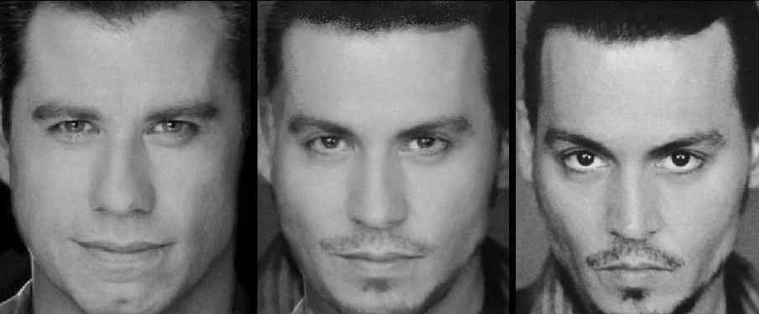
Measuring similarity
Confusability: probability of mistaking A for B

Slide 24
Measuring similarity
Confusability: probability of mistaking A for B

Slide 25
Measuring similarity
Confusability: probability of mistaking A for B
Is this the picture you saw?

Slide 26
Measuring similarity
Confusability: probability of mistaking A for B
A mistaken identity is a “confusion” and occurs for more similar items

Slide 27
Measuring similarity
Confusability: probability of mistaking A for B
Reaction time: time taken to distinguish A from B

Slide 28
Measuring similarity
Confusability: probability of mistaking A for B
Reaction time: time taken to distinguish A from B
Dissimilar = Easy = Fast

Slide 29
Measuring similarity
Confusability: probability of mistaking A for B
Reaction time: time taken to distinguish A from B
Similar = Hard = Slow

Slide 30
Measuring similarity
Confusability: probability of mistaking A for B
Reaction time: time taken to distinguish A from B
Forced choice: is X more like A or more like B?

Slide 31
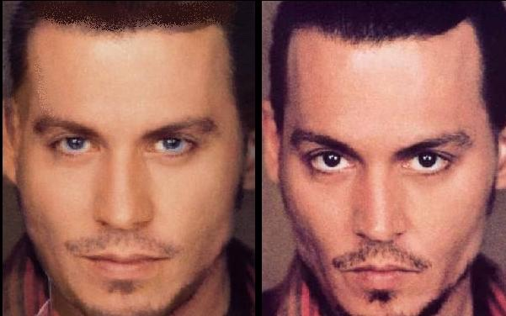
Measuring similarity
Confusability: probability of mistaking A for B
Reaction time: time taken to distinguish A from B
Forced choice: is X more like A or more like B?
OR
A X
X B

Slide 32
Measuring similarity
Confusability: probability of mistaking A for B
Reaction time: time taken to distinguish A from B
Forced choice: is X more like A or more like B?
Likert scales: how similar is A to B?

Slide 33
Measuring similarity
Confusability: probability of mistaking A for B
Reaction time: time taken to distinguish A from B
Forced choice: is X more like A or more like B?
Likert scales: how similar is A to B?
Extremely dissimilar 1 2 3 4 5 6 7 Extremely Similar

Slide 34
Measuring similarity
Confusability: probability of mistaking A for B
Reaction time: time taken to distinguish A from B
Forced choice: is X more like A or more like B?
Likert scales: how similar is A to B?
etc
Different methods produce subtly different data, but these are all reasonably effective ways of eliciting similarity data

Slide 35
Simple theories of similarity I: Geometric models

Slide 36
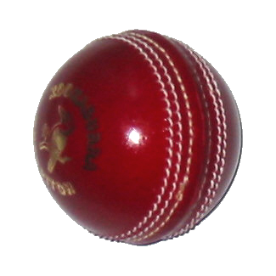
Distant things are dissimilar
Nearby things are similar

Slide 37
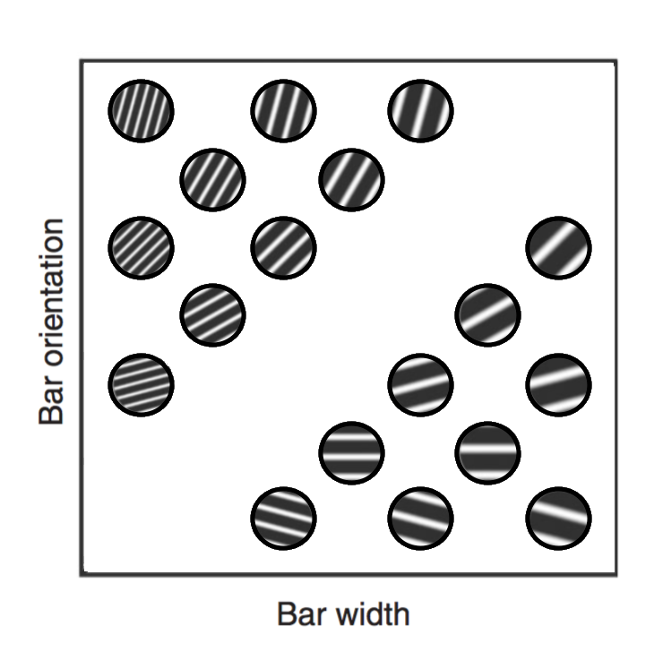
Distant things are dissimilar
Nearby things are similar

Slide 38
Geometric models
We have a “psychological space” with similar objects placed nearby

Slide 39
aunt
niece
cousin
uncle
nephew
grandmother
granddaughter
sister
grandson
daughter
grandfather
mother
brother
son
father

Slide 40
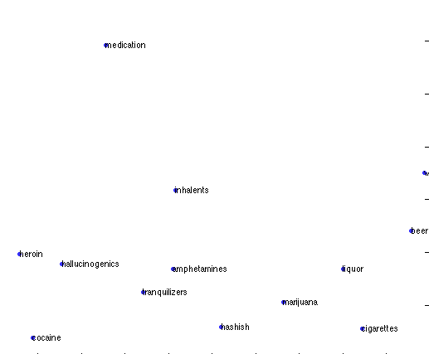
aunt
niece
medication
cousin
uncle
nephew
wine
inhalants
grandmother
granddaughter
beer
heroin
sister
grandson
lsd
amphetamines
liquor
daughter
grandfather
mother
tranquilisers
marijuana
brother
cocaine
son
cigarettes

Slide 41
Some empirical evidence?

Slide 42
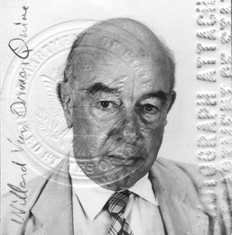
Similarity helps us generalise from one stimulus to another?
Nearby thing is probably edible
I know this is edible

Slide 43
Similarity helps us generalise from one stimulus to another?
Distant thing is probably not edible?
???
I know this is edible

Slide 44
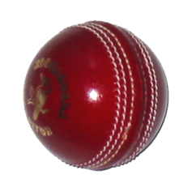
The “universal” law of generalisation
“Generalisation”
Roger Shepard
“Psychological distance”
The probability of generalising from one stimulus to another decreases exponentially as a function of dissimilarity (i.e. distance)

Slide 45
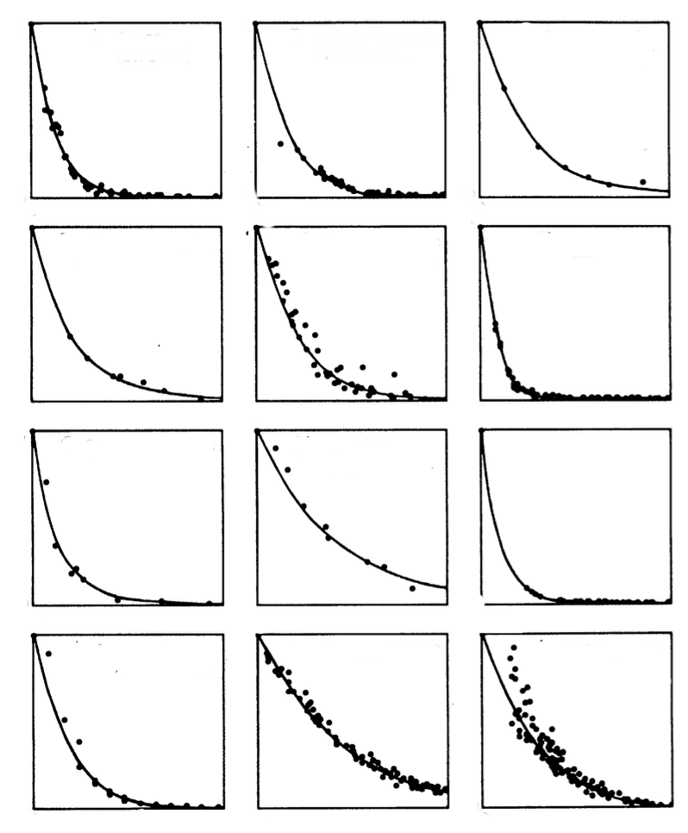
The “universal” law of generalisation
Invariance across stimulus types
“Generalisation”
Invariance across sensory modalities
d
p
g
θ
ŋ
t
Invariance across species
“Psychological distance”

Slide 46
Problems with the geometric approach

Slide 47
The symmetry constraint
aunt
The distance from A to B is the same as the distance from B to A… so similarity must be symmetric too!
niece
medication
cousin
uncle
nephew
wine
inhalants
grandmother
granddaughter
beer
heroin
sister
grandson
lsd
amphetamines
liquor
daughter
grandfather
mother
tranquilisers
marijuana
brother
cocaine
son
cigarettes

Slide 48
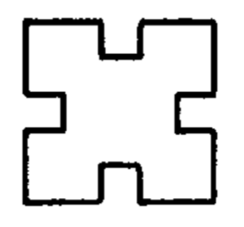
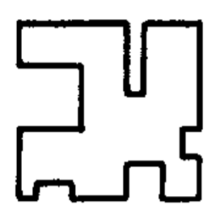
Which feels more appropriate?
(Tversky 1977)
A
B
“B is similar to A”
OR
“A is similar to B”

Slide 49
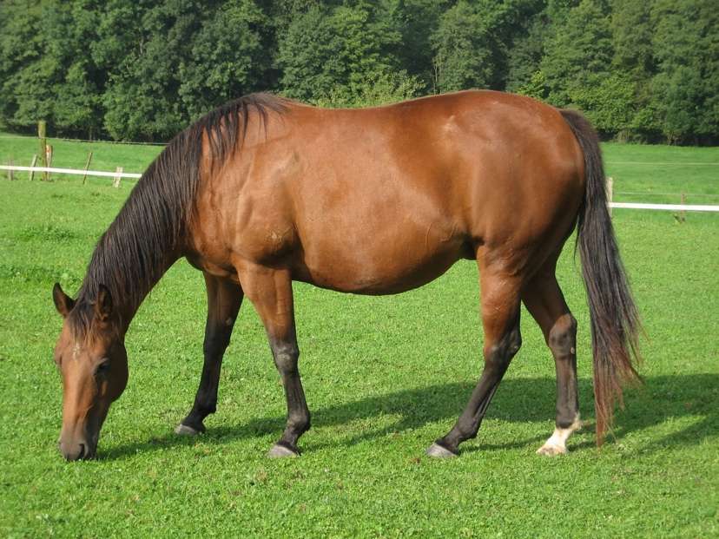
An okapi is like a horse
OR
A horse is like an okapi

Slide 50
Simple theories of similarity II: Featural models

Slide 51
Featural similarity
farms
domesticated
tail
fast
quadruped
strong
brown
mane
hooves
friendly
quadruped
hooves
stripy
tail
brown

Slide 52
Asymmetric knowledge
strong
mane
quadruped
stripy
domesticated
friendly
brown
farms
fast
hooves
tail

Slide 53
Common and distinctive features
(Tversky 1977)
Features distinctive to B
Features distinctive to A
Features common to A and B
Makes A dissimilar from B
Makes B dissimilar from A
Increases similarity

Slide 54
Richer theories of similarity: Structure alignment

Slide 56
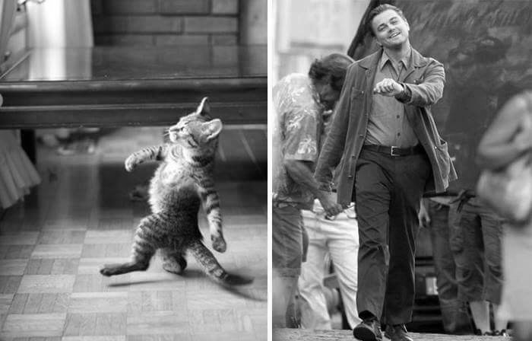
Removing the colour features leaves the similarity intact

Slide 57
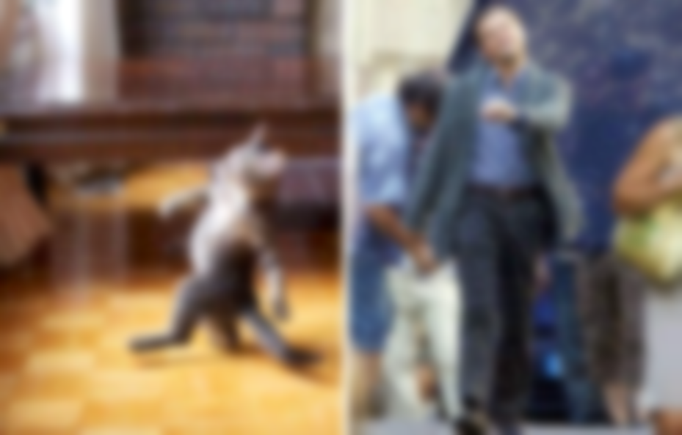
Blurring out the high-frequency spatial information leaves the similarity (mostly) intact

Slide 58
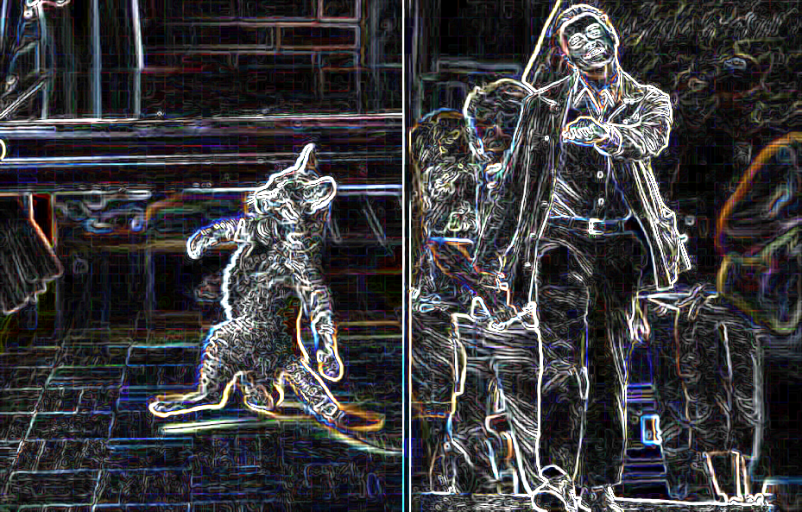
Filtering out everything except the high frequency information leaves the similarity intact

Slide 59
Deleting everything except a very rubbish cartoon leave the similarity intact

Slide 60
The structure does the work – what are the parts of each image and how do they related to each other?

Slide 61
Here are a pair of “butterflies”
A
B

Slide 62
Which of these pairs is more similar?
A
B
A
C

Slide 63
A
B
A
C

Slide 64
It’s always the same body parts
And always the same colours

Slide 65
But they’re bound into objects in different ways in both cases
A
B
A
C

Slide 66
A = {
head: yellow
body: brown
wings: blue
}
A
Object descriptions need to say something about this structure

Slide 67
Similarity?
Bug A
Bug B
When two objects share a feature (e.g., yellow), and that feature appears in the same slot (e.g., head), it is referred to as a “match in place” (MIP)

Slide 68
Similarity?
Bug A
Bug C
When the shared feature appears in a different location it is a “match out of place” (MOP)

Slide 69
Empirical prediction
If structure is important for similarity, MIPs should have a bigger influence than MOPs
>
1 MIP
1 MOP

Slide 70
To the laboratory!!!

Slide 71
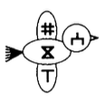
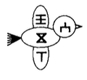
3 MIPS + 0 MOPS
Experiment! The task is to rate the similarity between these
Goldstone (1994)

Slide 72
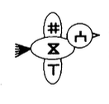
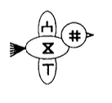
3 MIPS + 0 MOPS
2 MIPS + 2 MOPS
Experiment! The task is to rate the similarity between these
Goldstone (1994)

Slide 73
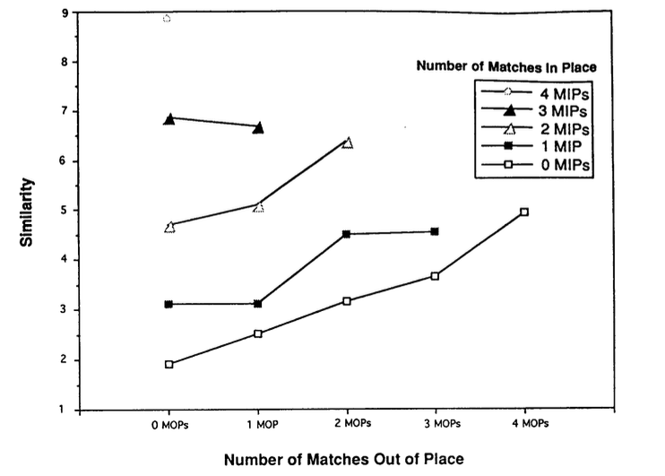
3 MIPS + 0 MOPS
2 MIPS + 2 MOPS
Goldstone (1994)

Slide 74
Adding a MOP causes similarity to increase
Goldstone (1994)

Slide 75
Adding a MIP also causes similarity to increase
Goldstone (1994)

Slide 76
Structure matters a lot!
MIPs have a bigger effect than MOPs
+3 MIPs
+3 MOPS
Goldstone (1994)

Slide 77
Richer theories of similarity II: Stimulus transformation

Slide 78
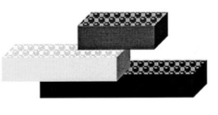
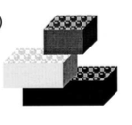
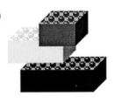
Similarity mirrors processes
Rotate object, create black, apply black
Squash
Split

Slide 79
Similarity mirrors processes
Rotate object, create black, apply black
Squash
Split

Slide 80
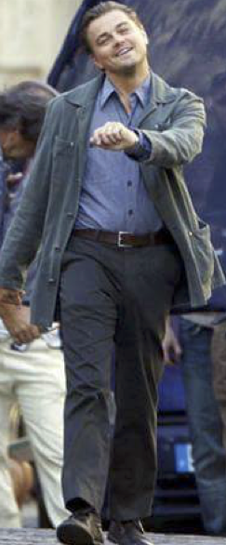
Similarity mirrors processes
Delete the human

Slide 81
Similarity mirrors processes
Shrink and rotate the skeleton
Delete the human

Slide 82
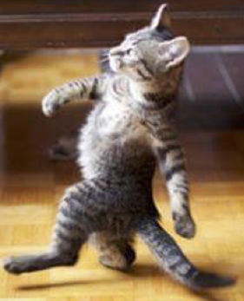
Similarity mirrors processes
Shrink and rotate the skeleton
Draw the cat
Delete the human

Slide 83
Stimulus transformations
Hahn, Chater & Richardson (2003)

Slide 84
Stimulus transformations
Hahn, Chater & Richardson (2003)
Step 1: “create” blue from a mental palette

Slide 85
Stimulus transformations
Hahn, Chater & Richardson (2003)
2 steps
Step 1: “create” blue from a mental palette
Step 2: “apply” blue where needed

Slide 86
Asymmetric similarity
1 step
Going back the other way we don’t need to “create” yellow because it’s already there!
Recall:

Slide 87
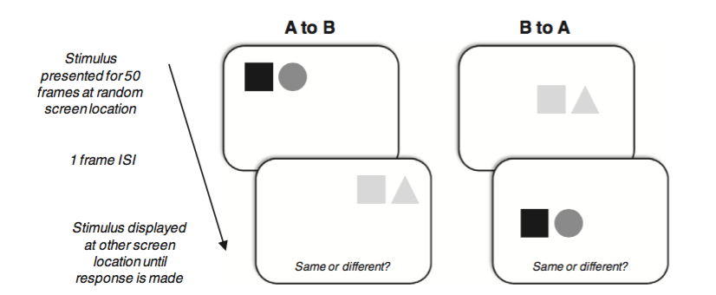
Hodgetts and Hahn (2012)
(speeded “same vs different” judgment)

Slide 88
Hodgetts and Hahn (2012)
(speeded “same vs different” judgment)

Slide 89
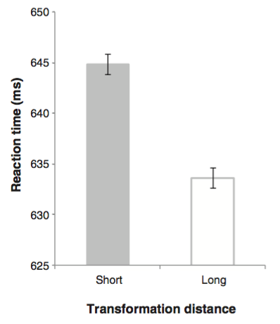
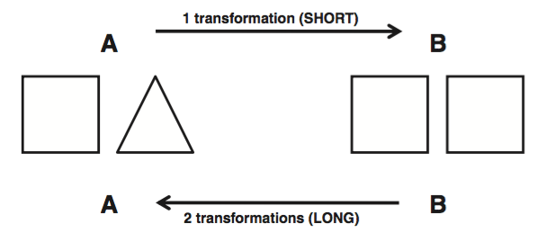
Hodgetts and Hahn (2012)
SHORT ⇒ more similar, more confusable, slower RT

Slide 90
Hodgetts and Hahn (2012)
LONG ⇒ less similar, less confusable, faster RT

Slide 91
Hodgetts and Hahn (2012)
SHORT
LONG

Slide 92
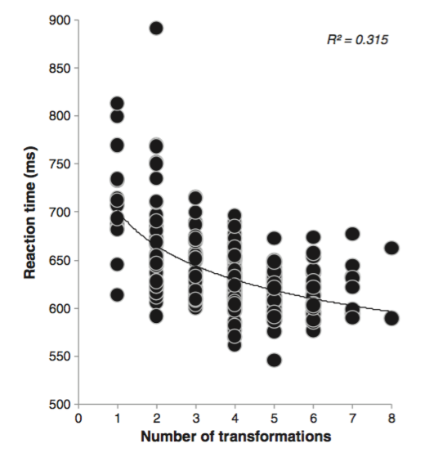
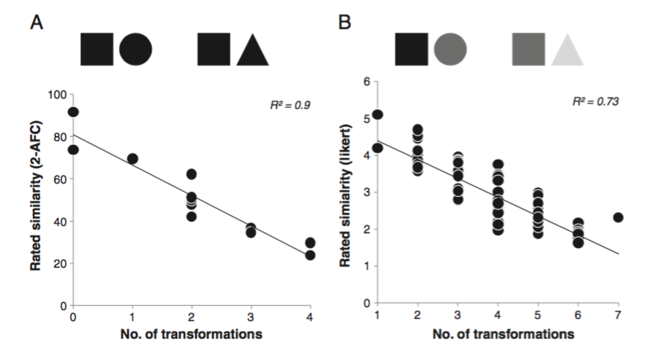
Various replications using different methods
(see Hodgetts & Hahn 2012)
Response time
Forced choice task
Similarity rating

Slide 93
Summary
Intro
What similarity is
How it is measured
Geometric similarity
“Universal” law of generalisation
Symmetry prediction
Featural similarity
Asymmetry due to different knowledge
Structure alignment
MIPs and MOPs
Goldstone experiment
Stimulus transformation
Asymmetry due to different structure
Hodgetts & Hahn experiment

